Slide 1

NLIIRS: A Question & Answering based Information Retrieval from Unstructured Information without Using SQL

Slide 2

Objective
This work can accept information in natural language text and can answer to the queries without storing or converting the data into natural language text.
It acknowledges the data as characteristic natural language text, process the data and the inquiries subsequently asked are reacted by NLIIRS as expression based answers
The upside of this framework is that it needn't bother with preparing or training.

Slide 3
Funding Agencies
This publication is an outcome of the R&D work undertaken project under the Visvesvaraya PhD Scheme of Ministry of Electronics & Information Technology, MeitY, Government of India, being implemented by Digital India Corporation. This research work has been done at Research Project Lab of National Institute of Technology (NIT), Durgapur, India. Financial support was received from Visvesvaraya PhD Scheme, Deity, Govt. of India (Order Number: PHD-MLA/4 (29)/2014_2015 Dated- 27/4/2015) to carry out this research work.
Special Thanks to NIT Durgapur
JUET Guna

Slide 4
Methodology
Query
text
Processing starts
Text Processing
Query Processing
tokenize
Tools Used (NLTK):-
Pos_tagger
Ne_chunker
Tokenizer
Stemmer
WordNetLemmatizer
t
q
pos
t
q
chunking
t
q
Comp. verb/noun/adj
Correct Answer
Factoid
[Reference 3]

Slide 5
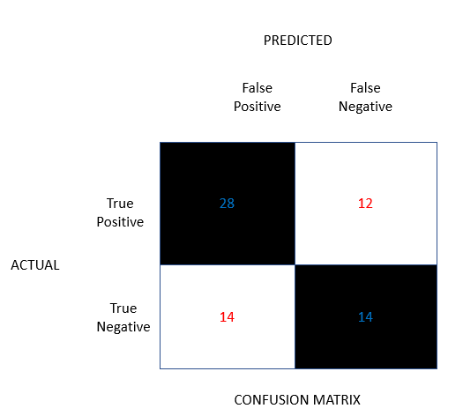
Experimental Results:- Confusion Matrix
True Positive = Predicted value is YES when Actual Value is YES
True Negative = Predicted value is NO when Actual Value is NO
False Positive = Predicted value is YES when Actual Value is NO
False Negative = Predicted value is NO when Actual Value is YES
Accuracy=(28+14)/(28+12+14+14)*100=61.7%

Slide 6
Experimental Results for the questions type “Who”
Total no. of Questions asked (68)
Answers came (68)
Answers not came (0)
Correct Answers (42)
Wrong Answers (26)
Summation of questions been asked | True Positive | True Negative | False Positive | False Negative | Accuracy
68 | 28 | 14 | 12 | 14 | 61.70%
[Reference 1,5]

Slide 7
Experimental Results for the questions type “Where”
 | No. of que. asked | Response
Not Answered | 38 | 11
Answered | 38 | 27
Not Correct | 38 | 9
Correct | 38 | 18
Accuracy = (Correct answers/ total questions asked)*100 =50.0%
[Reference 2]
Notes:
This result is only up to 38 questions, but afterwards, we have done the analysis of the results in a more precise way to take this count up to 64

Slide 8
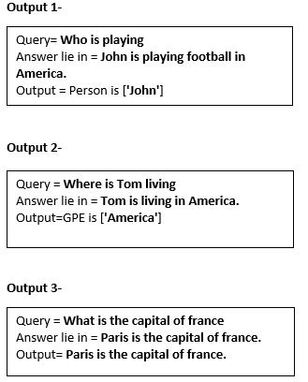
Sample Outputs for different types of questions
[Reference 4,6]

Slide 9

Comparative study table
NLIIRS
Information Retrieval from a Structured KnowledgeBase
Types | Questions
Factoid | Where do Steve comes from
Factoid | Who is playing Football
Descriptive | What are delicious
Others
Types | Questions
Factoid | When was the comet discovered
Factoid | How often does it approach the earth
Descriptive | In what countries was the comet visible on its last return
Others
asked 286 such questions, out of which only 125 are correct ,
Overall Accuracy % is equals to 43.70%.
Accuracy % is equals to 61.7% (“WHO” type questions)
Acc. % is equals to 50.0% (“WHERE” type questions)
[Reference 5]

Slide 10
Conclusion
This NLIIRS system accepts any natural language text.
This text can then answers the questions asked by the user in natural language in the factoid form.
The query asked by the user may be in the form of “Wh” category like “Who”, “Where”, “What”. The “What” class of user queries is not efficient in the present system.
This work does not uses the SQL or any other database to store the data and retrieve the information. Also, this work answers the queries in runtime only.

Slide 11
References
Prakash Ranjan, Rakesh Chandra Balabantaray, “Question Answering System for Factoid Based Question” in IEEE 2nd International Conference on Contemporary Computing and Informatics (IC3I), Noida, India 2016.
Mohit Iyyer, Jordan L Boyd-Graber, Leonardo Max Batista Claudino, Richard Socher, and Hal Daum´e III. 2014. A neural network for factoid question answering over paragraphs. In Empirical Methods in Natural Language Processing (EMNLP). pages 633–644.
Silviu Cucerzan and Eugene Agichtein “Factoid Question Answering over Unstructured and Structured Web Content“ Microsoft Research, One Microsoft Way, Redmond, WA 98052, 2011.

Slide 12
4. Danqi Chen, Jason Bolton, Christopher D. Manning “A Thorough Examination of the CNN/Daily Mail Reading Comprehension Task” Department of Computer Science Stanford University, Stanford, CA 94305-9020, USA, 2016
5. Avani Chandurkar, Ajay Bansal “Information Retrieval from a Structured KnowledgeBase” 11th International Conference on Semantic Computing IEEE, 2017
6. Jiang Bian, Eugene Agichtein, Yandong Liu, Hongyuan Zha “Finding the Right Facts in the Crowd: Factoid Question Answering over Social Media” WWW 2008 Proceedings of the 17th international conference on World Wide Web Pages 467- 476

Slide 13
